Slide 1





PREDICTING THE IMPACT OF GADGET ADDICTION ON STUDENTS USING AI

Slide 2

ABTSRACT
The widespread use of electronic gadgets among students has raised concerns about the potential negative impacts on their academic performance, mental health, and overall well-being.
This project aims to develop a predictive model using machine learning to analyze and forecast the effects of gadget addiction on students' lives.
By leveraging data such as screen time, academic records, sleep patterns, and social interactions, we explore the correlations and patterns that link excessive gadget use to adverse outcomes.
The project employs machine learning techniques, including random Forest, to build models capable of predicting the likelihood and severity of addiction-related consequences.
Our findings indicate that certain behavioral and academic indicators can reliably predict the impact of gadget addiction, offering an accuracy rate of over 97% with the most sophisticated models.

Slide 3


GADGET ADDICTION
INTRODUCTION
Electronic gadget addiction refers to an excessive and compulsive use of electronic devices such as smartphones, tablets, laptops, gaming consoles, and other digital devices, to the point where it negatively impacts an individual's daily life.
This addiction is characterized by a dependency on gadgets for activities such as gaming, social media, communication, entertainment, and even work, often leading to negative consequences on mental, physical, and social well-being.
Key Characteristics of Electronic Gadget Addiction:

Slide 4

EXISTING SYSTEM
Manual Surveys and Questionnaires
Traditional methods involve surveys and questionnaires where students self-report their gadget usage, academic performance, and well-being. These surveys are often conducted by schools, researchers, or mental health professionals.
Basic Statistical Analysis
Some systems use basic statistical methods to analyze data collected from students, such as correlating screen time with academic performance or mental health indicators. These methods might involve simple correlation or regression analysis.
Behavioral Monitoring Software
Certain schools and parents use software to monitor students' gadget usage, including time spent on specific apps or websites. This data is then reviewed to assess potential overuse.

Slide 5




DISADVANTAGES
Self-reported data can be inaccurate due to biases or students' reluctance to disclose their actual usage patterns. The analysis is often manual and may not capture complex relationships between variables.
01
While these tools provide real-time monitoring, they do not offer predictive insights. The data collected is often used reactively, rather than proactively, and there is a risk of invading students' privacy.
02

Slide 6
DISADVANTAGES
Basic statistical analysis often fails to capture the non-linear relationships between variables. It also lacks predictive capabilities, meaning it can identify existing issues but cannot forecast future outcomes.
03
Existing models may lack accuracy due to limited data and simplistic algorithms. They might not be widely implemented or accessible to most schools and parents, limiting their practical application.
04

Slide 7



PROPOSED SYSTEM

Slide 8


PROPOSED SYSTEM
The proposed system aims to predict the impact of electronic gadget addiction on students' lives by utilizing the Random Forest algorithm, a powerful and versatile machine learning technique.
The system will focus on analyzing various factors such as screen time, academic performance, sleep patterns, and social behavior to predict the likelihood of negative outcomes associated with excessive gadget use.

Slide 9
PROPOSED SYSTEM
The proposed system aims to predict the impact of electronic gadget addiction on students' lives using the Random Forest algorithm, a powerful machine learning technique known for its robustness and accuracy.
This system will collect and analyze data from various sources, including screen time, academic performance, sleep patterns, and social behavior, to identify and forecast potential negative outcomes associated with excessive gadget use.
By leveraging Random Forest, the system can handle complex interactions between multiple factors, providing reliable predictions while highlighting the most influential variables.
Additionally, the system will offer personalized recommendations and alerts based on the predicted risks, enabling timely intervention to mitigate the adverse effects of gadget addiction.

Slide 10
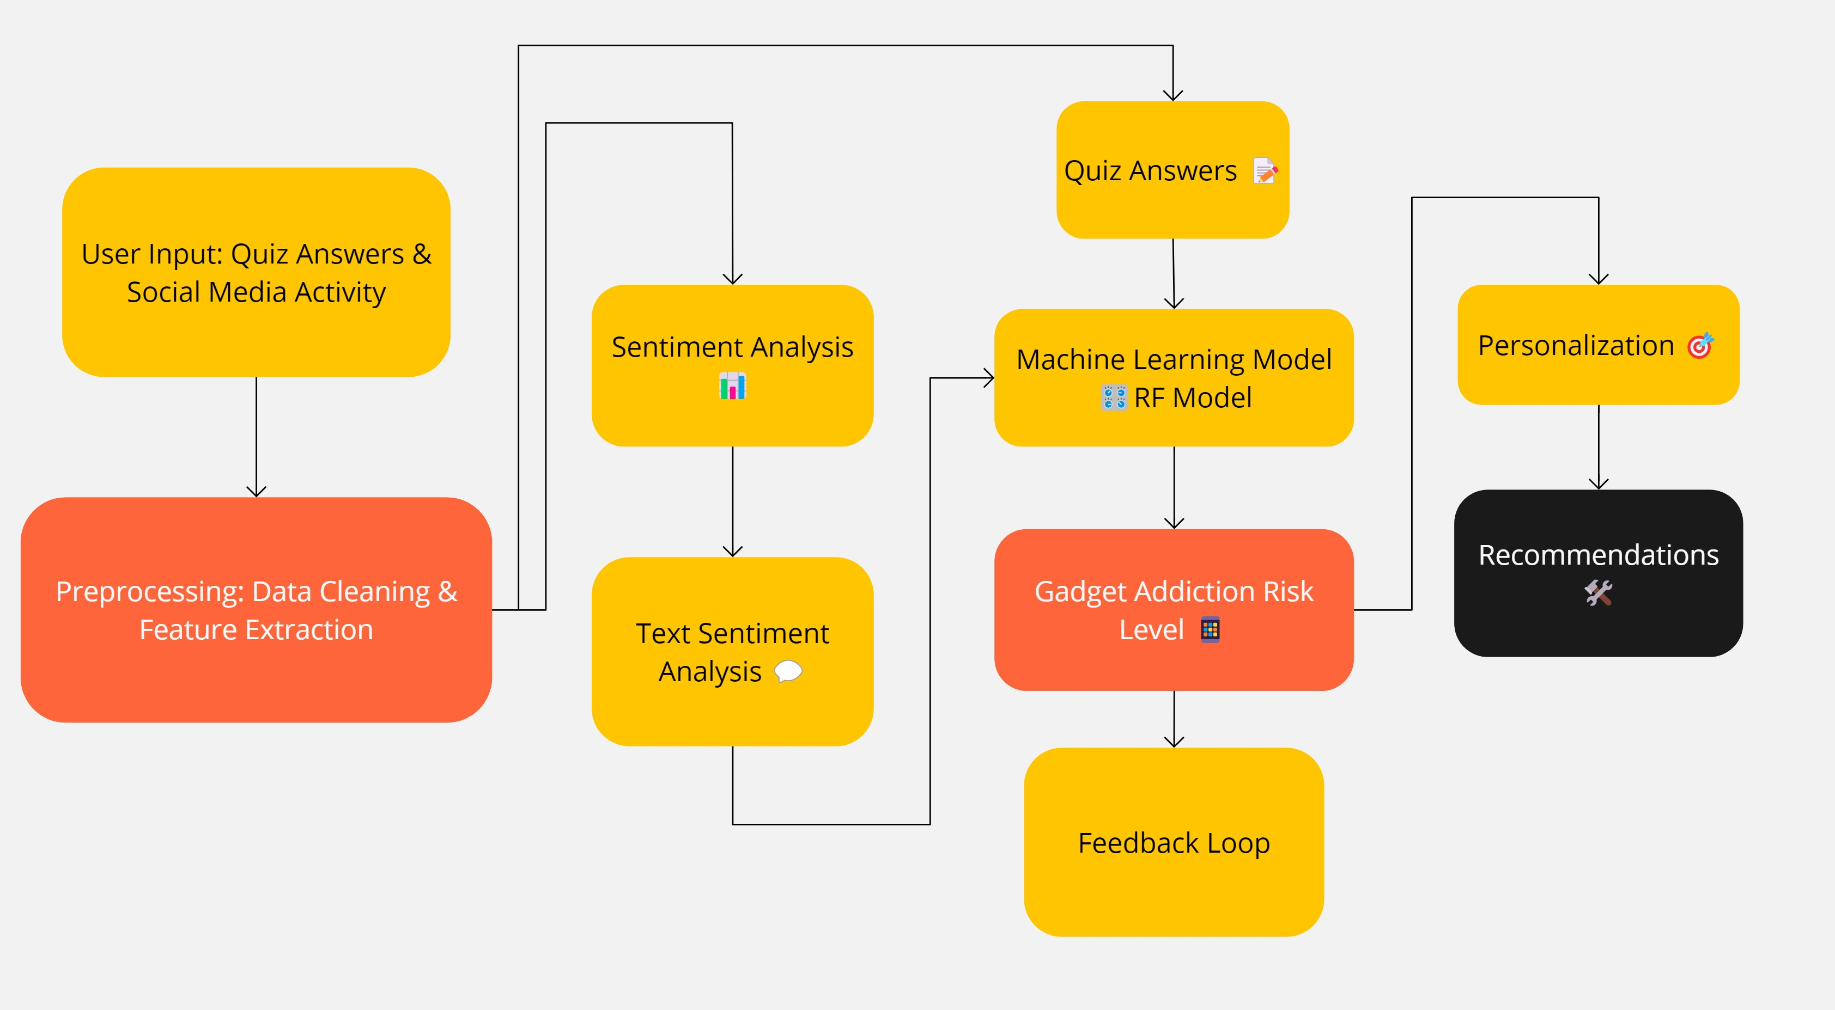
ARCHITECTURE

Slide 11





MODULES
MODULE 1
MODULE 2
MODULE 3
MODULE 4
Daatset Collection:
Screen time data (hours per day spent on different gadgets)
Academic performance records (grades, attendance)
Sleep patterns (average sleep duration, quality of sleep)
Behavioral data
Data Cleaning: Handle missing values, remove duplicates, and correct errors.
Feature Engineering: Create new features that could enhance prediction accuracy, such as the ratio of study time to screen time
Training the RF Model:
Random Forest is less prone to overfitting and handles a large number of features and complex interactions between them.
The dataset will be split into training and testing sets. The Random Forest model will be trained on the training set using a large number.
Evaluation Metrics: Introduction to key evaluation metrics, such as accuracy, precision, recall, and F1 score, tailored for assessing the efficacy of RF-based Addictiondetection.
For each student, the model will predict the likelihood of experiencing specific negative outcomes due to gadget addiction.

Slide 12
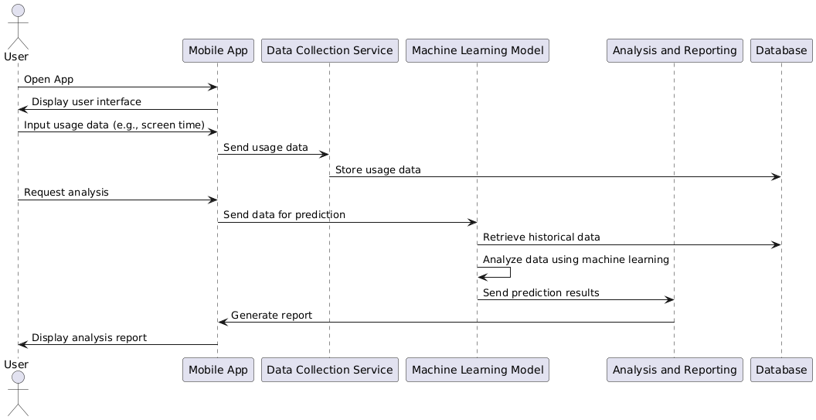
SEQUENCE DIAGRAM

Slide 13
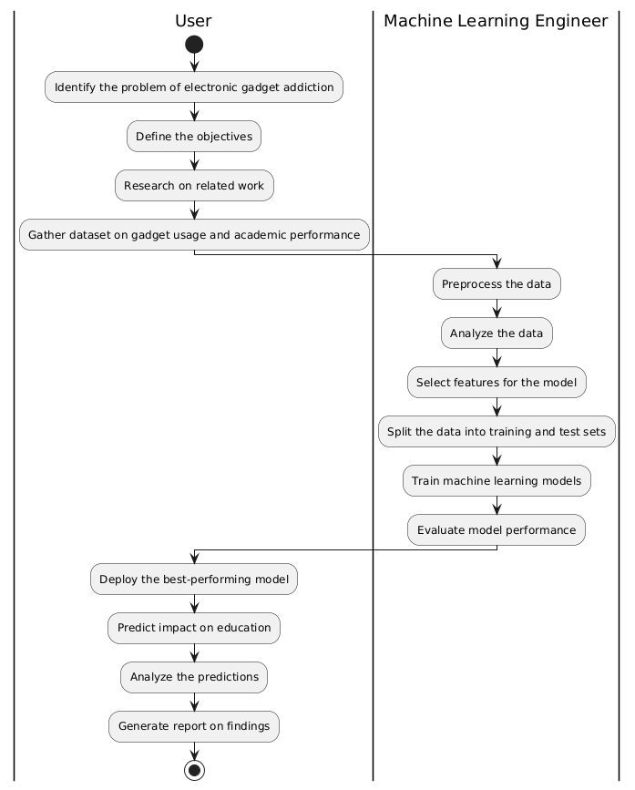
ACTIVITY DIAGRAM

Slide 14
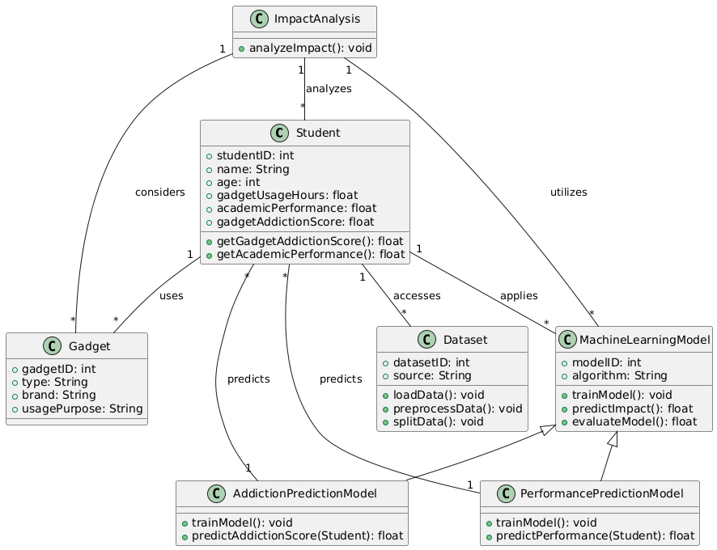
CLASS DIAGRAM

Slide 15
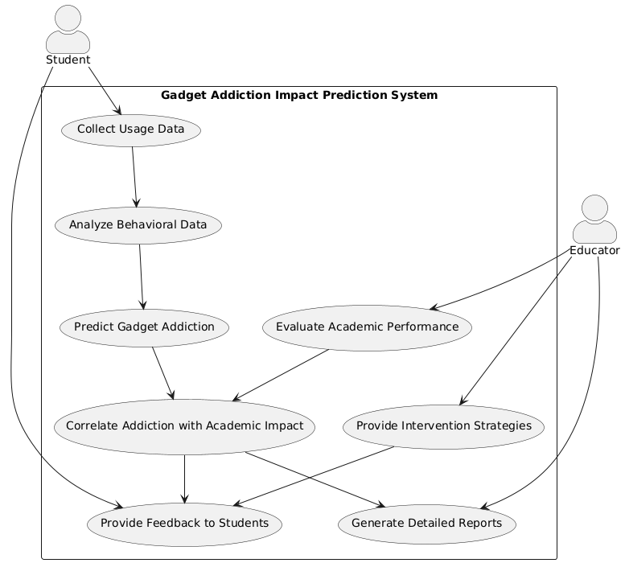
UML DIAGRAM

Slide 16






ADVANTAGES
HIGH ACCURACY AND ROBUSTNESS
Random Forest is an ensemble learning method that combines the predictions of multiple decision trees to produce a more accurate and stable result.
HANDLES COMPLEX INTERACTIONS
Random Forest can effectively manage complex interactions between various factors, such as screen time, academic performance, sleep patterns, and mental health indicators.
FEATURE IMPORTANCE
One of the key advantages of Random Forest is its ability to rank features by importance. This helps in understanding which factors

Slide 17
HARDWARE/SOFTWARE REQUIREMENT
HARDWARE REQUIREMENTS:
System : Pentium i3 Processor.
Hard Disk : 20 GB.
Monitor : 15’’ LED
Input Devices : Keyboard, Mouse
Ram : 4 GB
SOFTWARE REQUIREMENTS:
Operating system : Windows 10 Pro, MAC OS
Coding Language : Python 3.10.9, HTML, CSS,JS
Web Framework : Flask

Slide 18

CONCLUSION
The project demonstrates the potential of using machine learning, specifically the Random Forest algorithm, to predict the impact of electronic gadget addiction on students' lives.
By analyzing a diverse set of factors including screen time, academic performance, sleep patterns, and social interactions, the Random Forest model provides valuable insights into how excessive gadget use can affect various aspects of a student's well-being.
This predictive approach not only enhances our ability to identify students at risk but also supports proactive intervention strategies.
In conclusion, this project represents a significant step forward in managing the challenges of gadget addiction.

Slide 19
REFERENCE
[1] Zhiqing Guo, Gaobo Yang, Jiyou Chen, Xingming Sun (2021) “Fake face detection via adaptive manipulation traces extraction network” in Computer Vision and Image Understanding-Volume 204.
[2] Belhassen Bayar and Matthew C. Stamm (2016) “A Deep Learning Approach to Universal Image Manipulation Detection Using a New Convolutional Layer” in IH & MM Sec '16: Proceedings of the 4th ACM Workshop on Information Hiding and Multimedia Security.
[3] Richard Zhang et al., (2018), “Making Convolutional Neural Networks Shift-Invariant Again” in ICML 2019.
[4] Sheng-Yu Wang, Oliver Wang, Richard Zhang, Andrew Owens, and Alexei A Efros. CNN-generated images are surprisingly easy to spot...for now. In IEEE Conference on Computer Vision and Pattern Recognition, 2020.
[5] Carlini, N. and Farid, H. (2020) “Evading deep-fake-image detectors with white-and black-box attacks” in IEEE Conference on Computer Vision and Pattern Recognition (CVPR) Workshops.

Slide 20





RESOURCES

Slide 21
THANK YOU!

